Slide 1
Architecture Project
By: James Zartman
METC-107

Slide 2
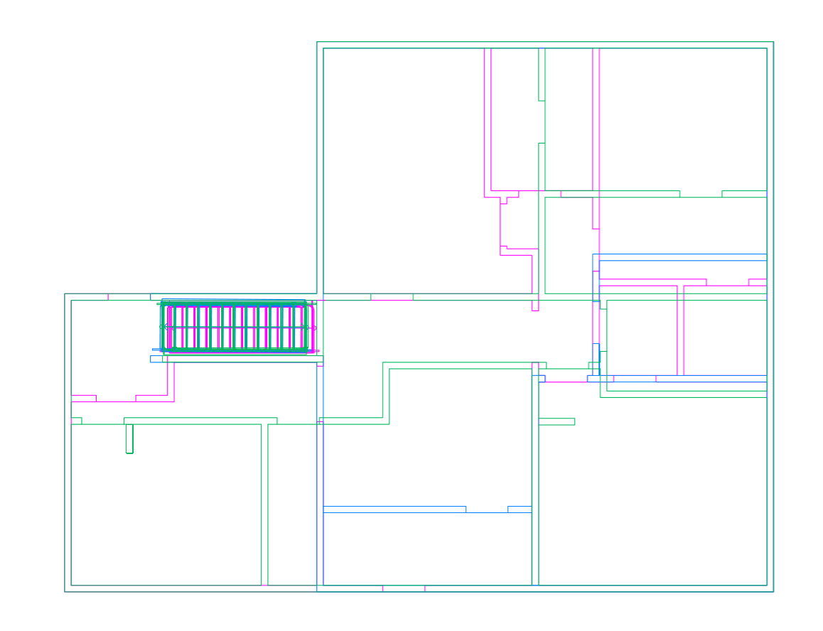
Home Layout
2 floors with a basement
Magenta is first floor
Green is second floor
Blue is Basement

Slide 3
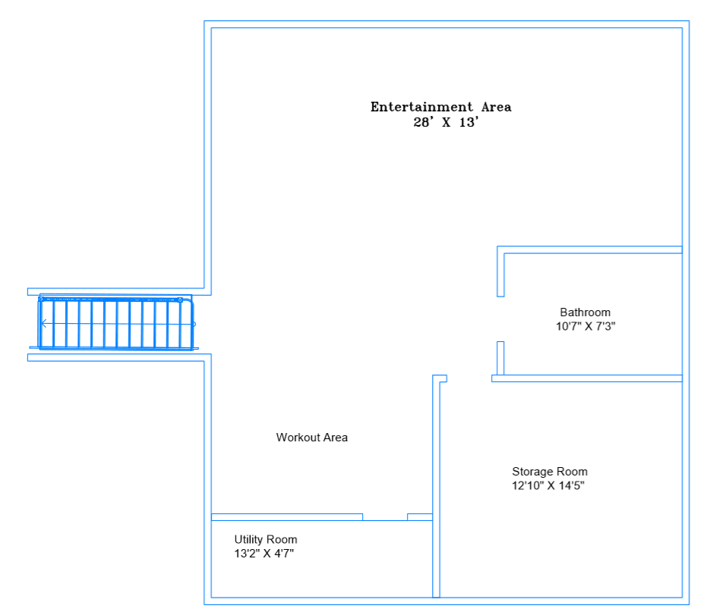
Basement layout
Square footage of basement: 1000 sq. ft

Slide 4
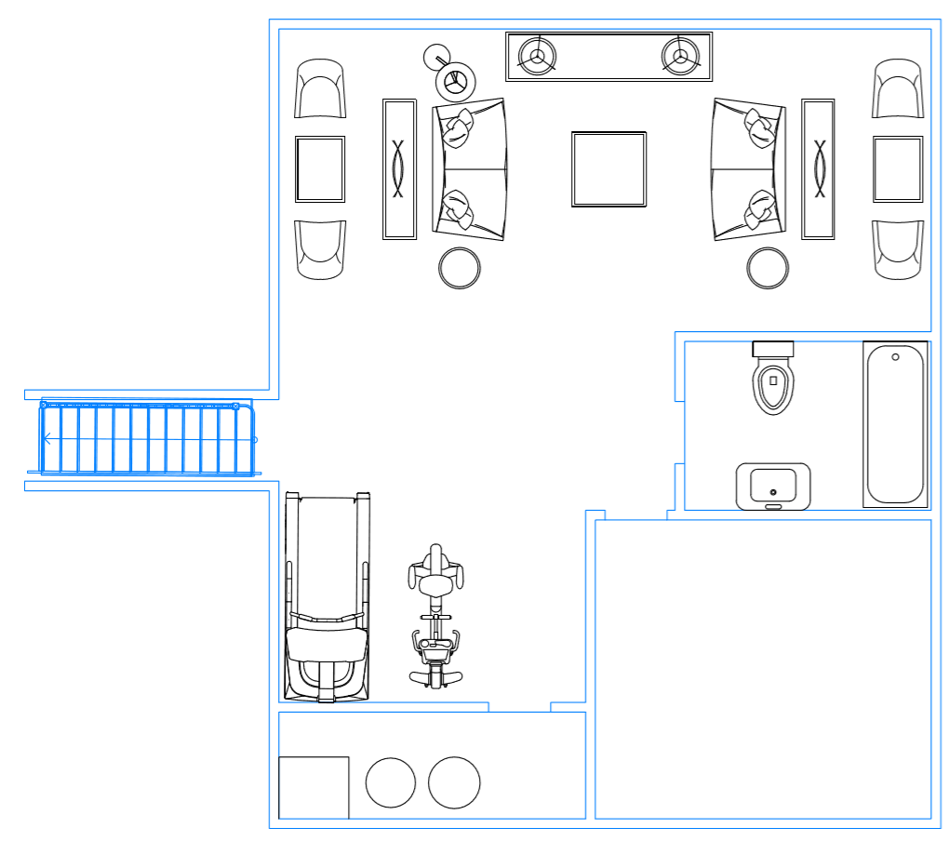
Basement Layout

Slide 5
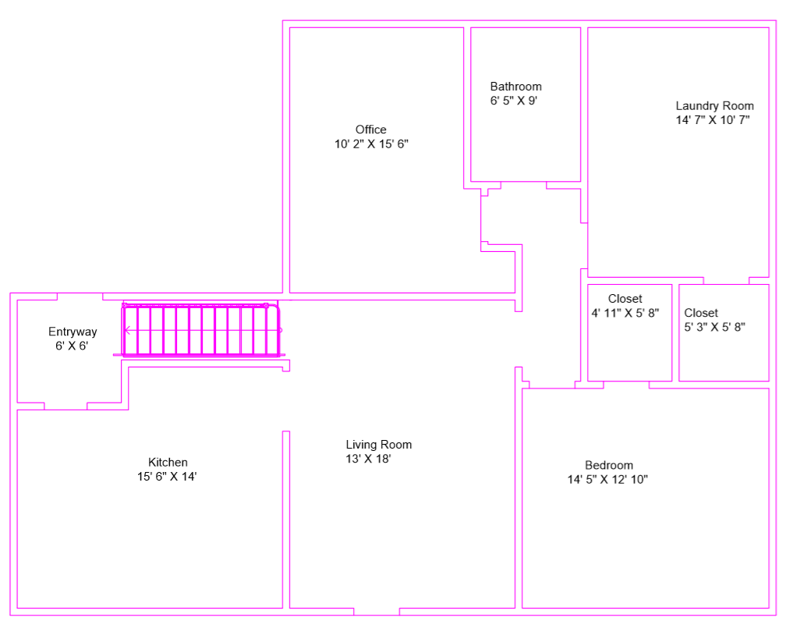
First floor Layout
Square footage of
First floor: 1309 sq. ft.

Slide 6
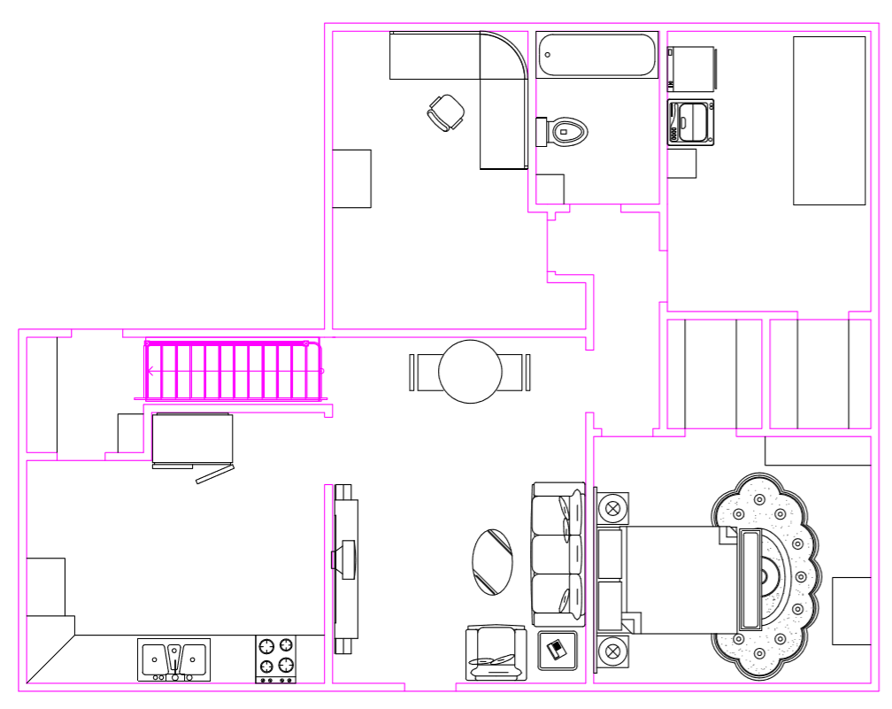
First floor with Furniture

Slide 7
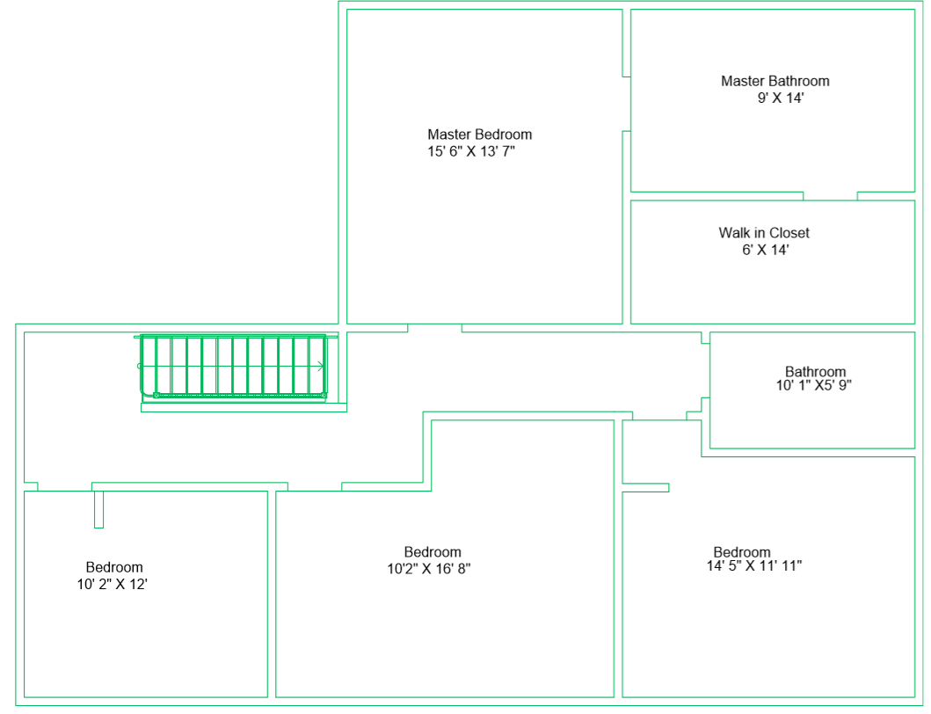
Second Floor layout
Square footage of
The second floor:
1309 sq. ft.

Slide 8
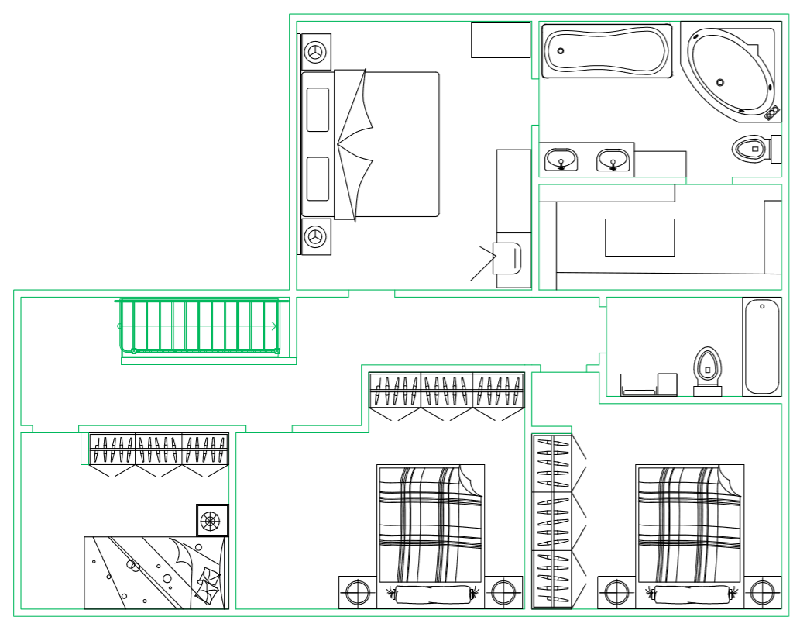
Second Floor with Furniture

Slide 9
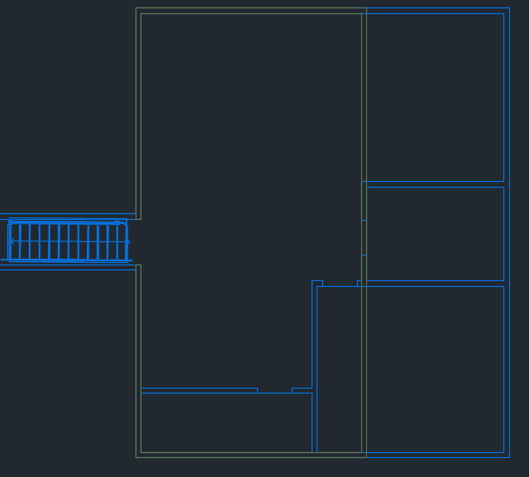
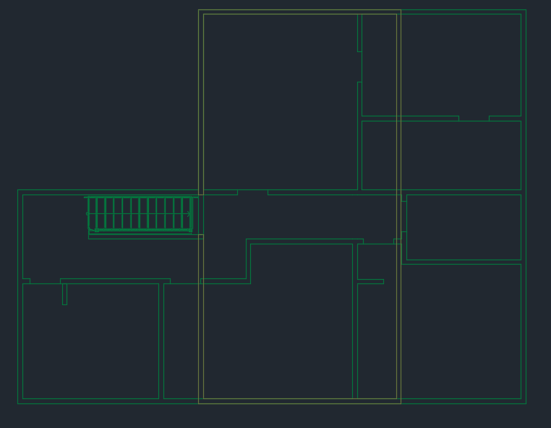
Existing
Basement
Second floor- as it stands- attic

Slide 10
Cost
Whole first floor currently exists along with partial second floor and basement
Total square footage after remodel is 3618 sq. ft.
  Huge
Found that average in the area to build at approximately $115 per sq. ft.
With the existing floor plans there would be approximately 1160 square feet added, or new addition.
So with the 1160 sq. ft. added that on average is a cost of approx. $135,000.

Slide 11
Advantages and Disadvantages
Advantages
  I like that there would be a nice entertainment/ family room in basement
  Master bath and bedroom added
Disadvantages
  To add on or even pull permits, will have to move well (too close to house) and put in $15,000 mound in back yard (septic)
  The existing floor plan to build in todays time is approx. 2458 sq. ft. however only 1309 sq. ft. are currently livable.
    Costs $282,670
    House as it sits is only worth $100,000

Slide 12
Sources
https://www.realtor.com/

